Slide 1
SENTIMENTAL ANALYSIS WITH WEB SCRAPING
Project Team ID:
CSE20PT40
GUIDE: SAVITA S
Assistant Professor Dept. Of CSE,
CSE, JSSATEB
TEAM MEMBERS
Dhruva V | 1JS18CS403
Pruthviraj G | 1JS18CS416
Purushothama N | 1JS18CS420
Gagan M S | 1JS17CS035

Slide 2
ABSTRACT
E-commerce is getting used more and more these days to purchase products in an online store. A product review is usually used see if the product is worth buying or not.
This product used by selecting URL a product in amazon.in website opened in a browser, copy the URL first and open this product website and paste it in the input box and press enter, then this product processes the request and shows the score that the selected product has got and a wordcloud image
The result of this project has shown success by show the result.

Slide 3
INTRODUCTION
Sentimental analysis
Machine learning
Web-scraping
Flask

Slide 4
AIMS and OBJECTIVES
AIMS:
Our first aim is by using the web scrapping we generate the unstructured data from the amazon product pages.
To the scrapped data, we create a machine learning model and it is used for analyzing the sentiments of the cleaned data.
By doing so, with the help of the model we can classify the sentiment intensity (positive, negative or neutral) of the scrapped data.
At last the output will be integrated with the help of flask and bootstrap. (extra: bootstrap-->it is the most popular html, CSS and JS library in the world)
OBJECTIVES:
The main objective behind this project is to provide a platform which will enable users to check the credibility of a retailer/product by scanning reviews.
Instead of going through potentially hundreds of reviews, our platform offers a one-click result.

Slide 5
Problem Statement & Motivation
The Primary focus of this project is to find the sentimental scores of a product review by the customers.
The main motivation behind the project is to understand the reviews submitted online by varying customers for a product. With knowing the product has positive or negative reviews we can have a clear understanding of the reviews submitted.

Slide 6
SYSTEM
EXISTING SYSTEM:
The existing system has many limitations:
Sentiment model is a separate unit that hasn’t been integrated with web scrapping
It is more complex to implement and its expensive. There is lack of credible user interface.
PROPOSED SYSTEM:
Integration of both modules (web scrapper and sentiment analyzer) into a single unit.
Developing a user interface using flask and bootstrap.
Providing better result on the scrapped Data by implementing VADER intensity analyzer.
VADER allows us to rate the reviews based on the emotions in the text.
We generate a word cloud, which is a data visualization technique used for representing text data in which the size of each word indicates its frequency or importance.

Slide 7
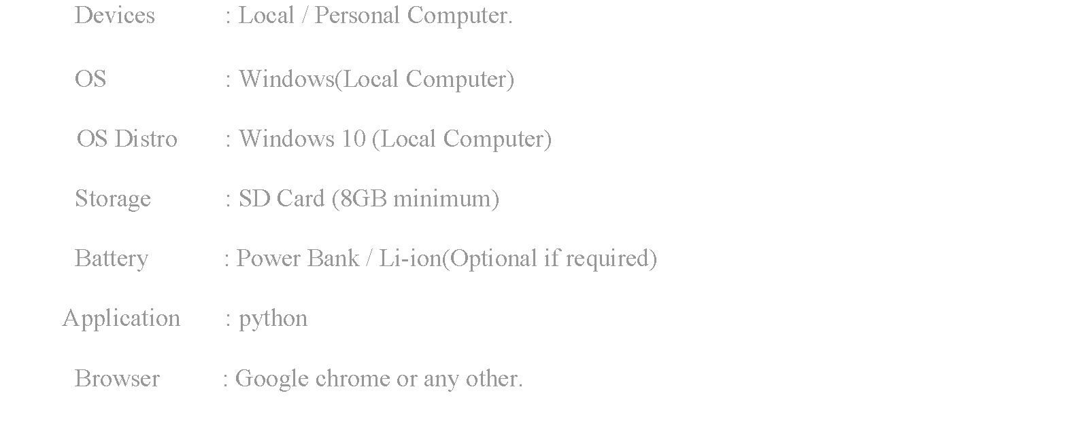
SYSTEM REQUIREMENTS

Slide 8
DESIGN AND IT’S IMPLEMENTATION
SYSTEM DESIGN
Front End
Link For
The Product
Web Scraping Unit
Scraped Data
(reviews and rating)
Result For
The Product
Data Cleaning Unit
Cleaning Data
Removed special char
EDA Model
Processed Data
Sentimental Model

Slide 9


DESIGN AND IT’S IMPLEMENTATION
FRONT END
CLIENT
BROWSER
REQUESTS
WEB SERVER
HTTP REQUESTS
HTML & JSON
The user can interact with our product through the web page
This is implemented using Flask & Bootstrap 5
Link for the product is sent to server

Slide 10
DESIGN AND IT’S IMPLEMENTATION
WEB SCRAPING UNIT
Load Web Pages With ‘request’
The HTTP request returns a Response Object with all the response data (content, encoding, status, and so on)
Using a library called BeautifulSoup in Python to do web scraping.
Do for all review page
At end saved to a .csv file
Scrap the reviews data
Append New Data
Last Page?
NO
YES
Save to a .csv file

Slide 11
DESIGN AND IT’S IMPLEMENTATION
Data Cleaning Unit
In the cleaning unit we remove the unwanted data from the[i.e. scraped text data] then we convert the text[review column] to lowercase and remove integers or numerical in text.
Punctuations, null values and extra[spaces as they don’t make any sense] and all these things are done by importing regular expressions[import re] Stop words are ‘this is in’, which does not add much value.
So, we remove them to decrease the size of data set this process is called normalizing text[with spacy]spacy is most versatile and widely used library in NLP Lemmatization is nothing but normalization of words which means reducing a word into its root form.
LOAD CSV FILE
CLEAN DATA
CLEANED DATA

Slide 12
DESIGN AND IT’S IMPLEMENTATION
SENTIMENTAL MODEL
Sentiment analysis is done VADER technique:
VADER[Valence Aware Dictionary for sentient Reasoning] is a Unsupervised model used that is adaptive to interpret emotional [positive/negative] and emotional [strength] text feelings..
VADER is focused on the lexicons of words related to sentiment. Each of the words in the lexicon is rated as to whether it is positive or negative and assigns scores to them.
It uses to polarity scores method to get the sentiment metrics for a piece of text.
CLEANED WORDS
VADER TECHNIQUE
RESULT

Slide 13
DESIGN AND IT’S IMPLEMENTATION
EDA MODEL
EDA stands for Exploratory Data Analysis.
It is a process of exploring data, generating insights, testing hypotheses, and revealing underlying hidden patterns in the data.
We will create a Document Terms Matrix that we’ll later use as our analysis to get the insights in data and with the help of wordcloud.
CLEANED WORDS
EDA TECHNIQUE
RESULT

Slide 14
Modern tool usage
Here we use different python modules;
FLASK MODULE : Flask is a lightweight WSGI web application framework.
AMAZON_PRODUCT_REVIEW_SCRAPER MODULE : Uses the Amazon Simple Product API to provide API accessible data.
PANDAS MODULE : pandas is a Python package that provides fast, flexible, and expressive data structures designed to make working with structured (tabular, multidimensional, potentially heterogeneous) and time series data both easy and intuitive.
REQUESTS MODULE : The requests module allows you to send HTTP requests using Python.
BeautifulSoup MODULE : Beautiful Soup is a library that makes it easy to scrape information from web pages.
and many more modules

Slide 15
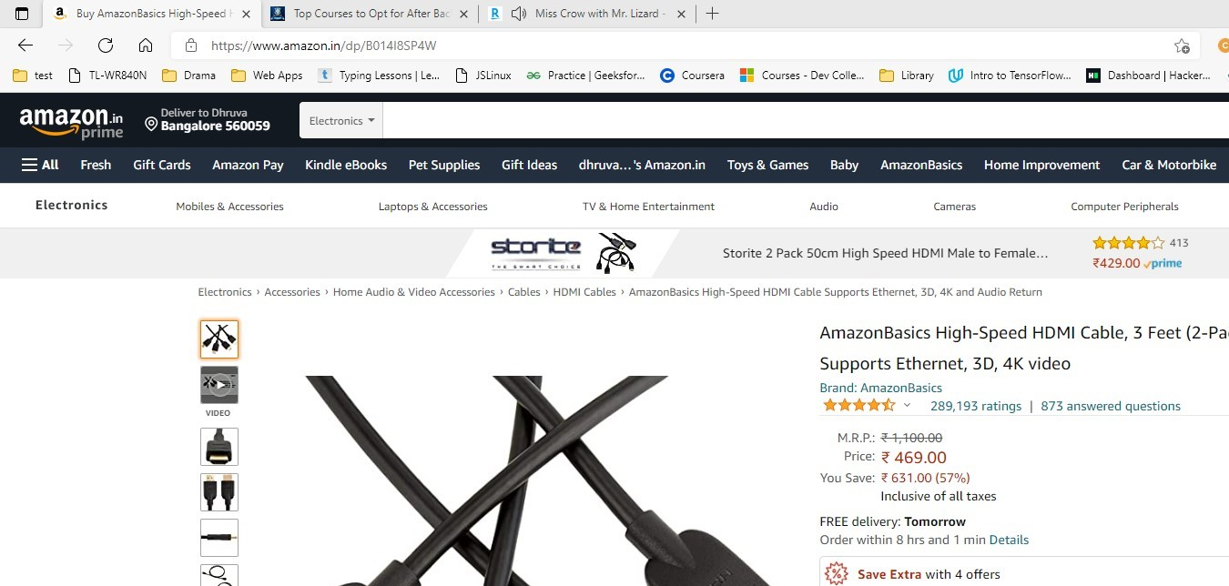
SNAPSHOTS

Slide 16
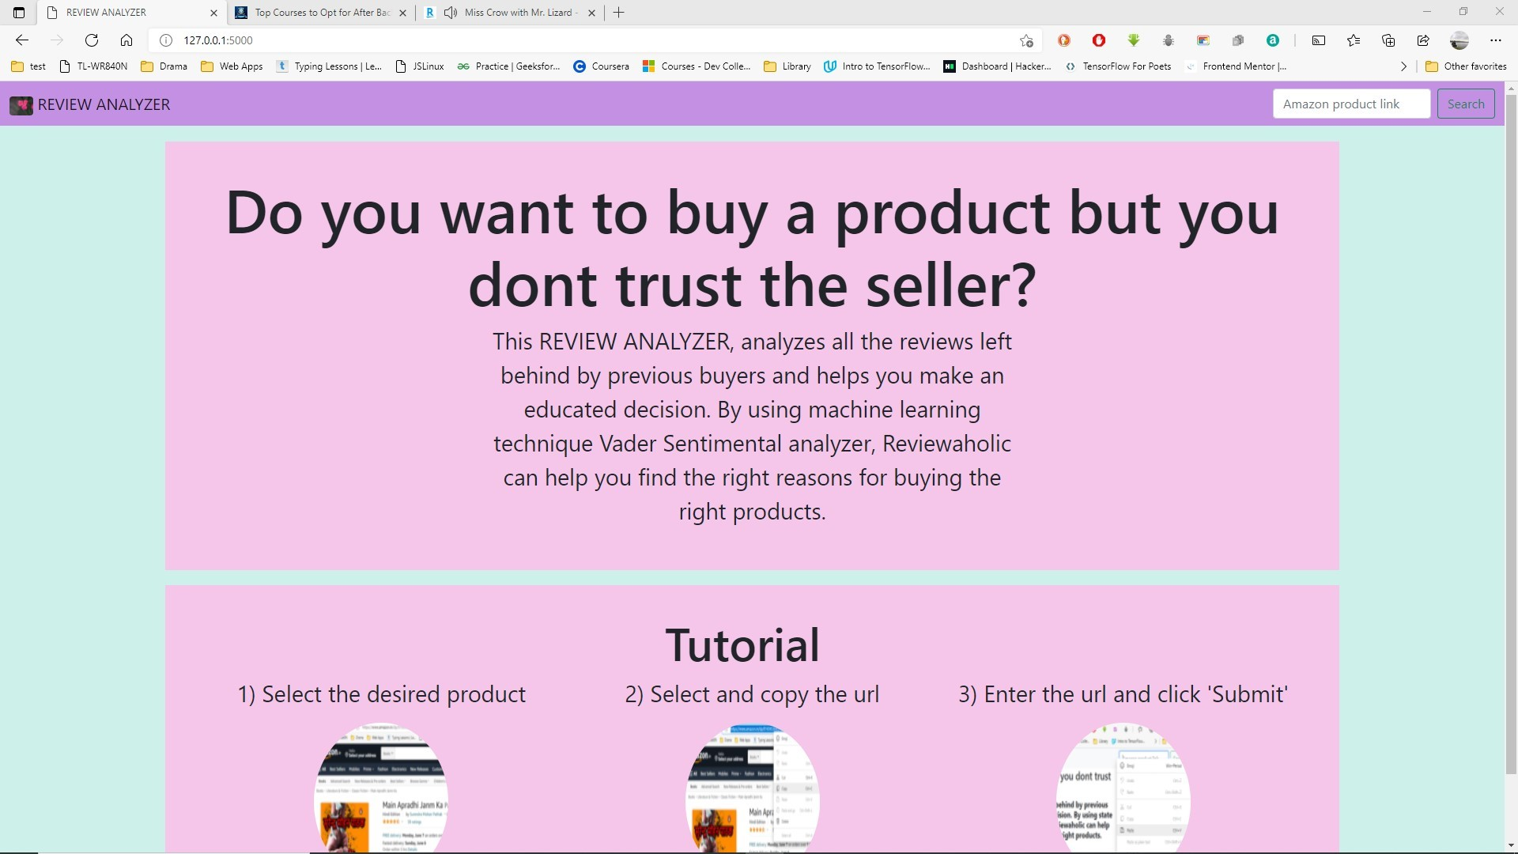
SNAPSHOTS

Slide 17
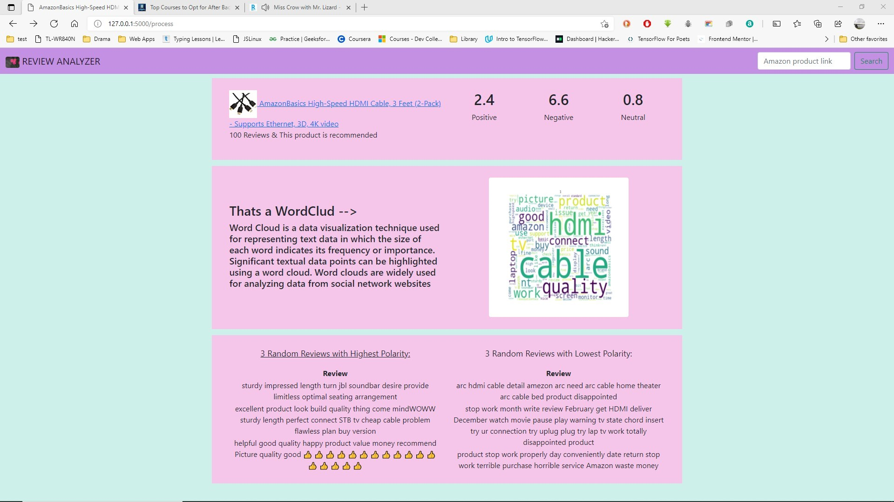
SNAPSHOTS

Slide 18
FUTURE WORKS
If partnered with amazon.in you do multiple requests without using any round about method.
If Vader dataset improved it can access more words
If Vader algorithm is improved we get better result
Implement continuous learning
Improve loading time

Slide 19
CONCLUSION
The task of sentiment analysis especially in the domain of web scrapping is still in developing stage and far from complete. We propose a model which we feel are worth exploring in the future and may result in the further improved performance. In this way, the effects of human confidence can be visualized in sentiment analysis

Slide 20
THANK YOU

